Slide 1
Internal Project
Web Report
Round 1 Comments
14 Sep 2016

Slide 2
Introduction and Summary
We (AceEngineer) are looking forward for the web report to provide for client with interactive charts and engaging them in the report.
Key comments are:
Bullet Points
White space
Charts
Cross references ()
Consistent Footer for every page (Only a small footer to show project info, etc. else a waste of space on active page)
Page length adjustment
Separate page for Client and Our logo (or something like starting page header which becomes small when scrolling down)
Login page

Slide 3
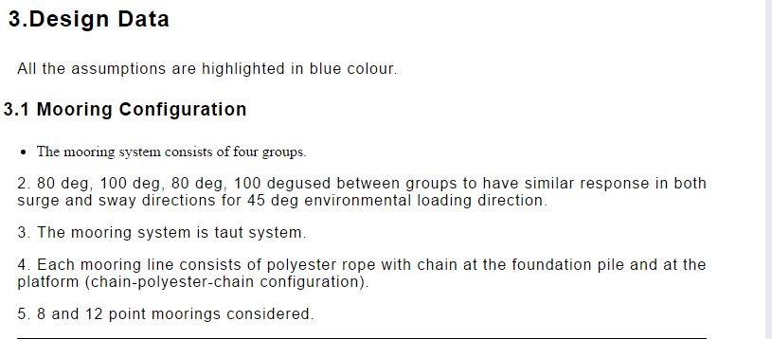
Bullet Points
The format of the line or paragraph is changing when we are using the bullet points option for writing the text.
Provide an option or guide to show where the text format is so we can easily alter.

Slide 4
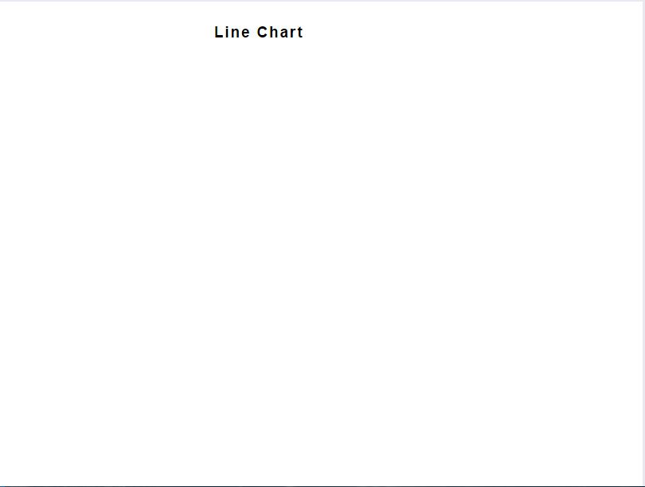
Charts
The charts are disappearing when we change any matter or add matter to the report.

Slide 5
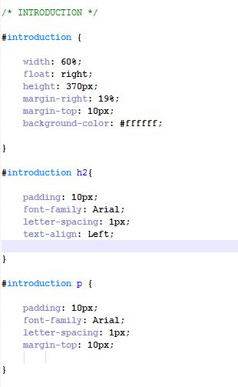
Comments in Code
Please write comments in the code where ever you can. It will help us a lot while editing and using the code.

Slide 6
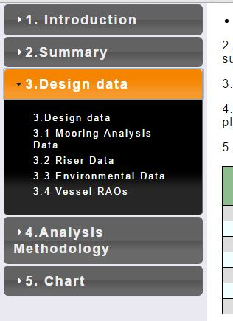
Hyperlink
The hyperlink in the navigation menu is not working with the updated content.
The variables defined are not matching the hyperlinks. Even after correcting this, links are not working.

Slide 7
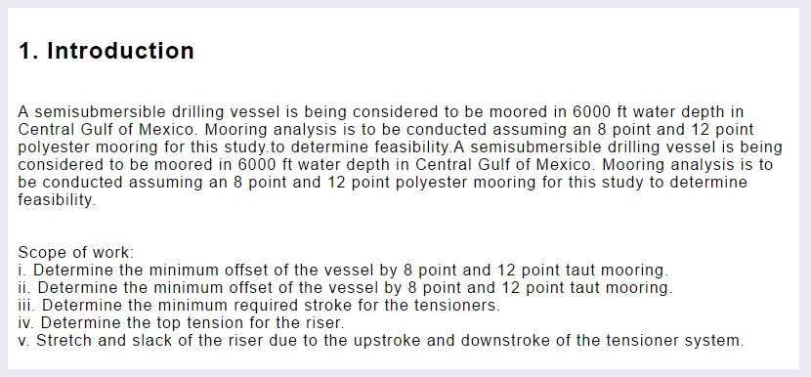
Paragraphs
Lot of white space is being waste for every paragraph. Please adjust the css to utilize the space completely.
(or) best is to comment the CSS so any one can update/alter as needed.

Slide 8
Cross References
Please write the code for cross references in a paragraph for images and charts.
I think we need a design or plan for this. Too vague comment.

Slide 9
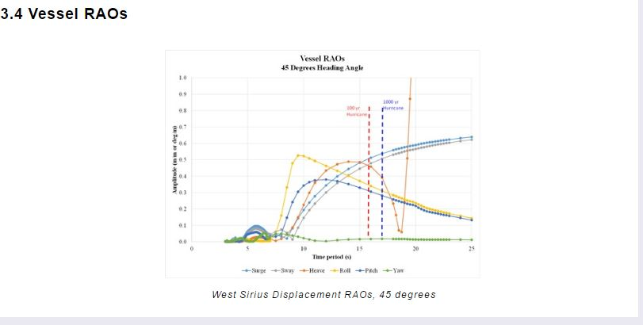
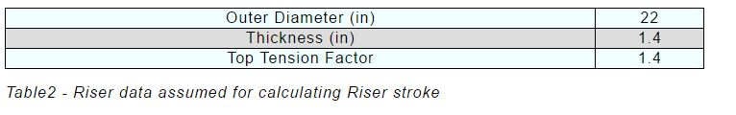
Format
Please write a new style in css for text below images, tables and charts.

Slide 10
Page Layout
Please make the content to be adjusted in A4 sheet. It will be very tedious to adjust the height of the white space every time we add or delete the text to the report.
Make the text/content to move to other page if the A4 sheet is completely used.
Agree. Why do we need pages. Make it continuous so we minimize this formatting of text/pictures.

Slide 11
Additional Requirements
A login page is required. Which needed to interact with the server every time when some one logged in to access the report.
Require a first page with the AceEngineer logo , Project name, details and Client logo.
We need a design for first page start and then a compressed small header and small footer as users scroll.

Slide 12
THANK YOU
For the opportunity to serve!

Slide 13
Document Revision History
01 | Round 2 comments. Round 1 comments in PRE-0006-01 | 12 Sept 2016 |  | GSY | VA
Rev | Description | Date |  | Author | Checked | Approved
Document No: |  |  | Client Ref:
0119-PRE-0007-01 |  |  | n/a

